Slide 1
Welcome to Web Treasure HUNT - 2014
Team Name:

Slide 2
Basic rules
Recommended search Google.com
Points vary for each question
Maximum of 3 negatives for full answer ( -40 PA)
Partial answers maximum 3 ( -25 PA )
Hints maximum 5 ( -15 PH )
Doubt clearing ( -5 per doubt )
Do not help or discuss with members from a different team.
No team member is allowed to go to other team’s places ( -5 per offence )
Think out of box, improve your searching skills.
Even if you solve last clue still the final treasure puzzle has to be solved from answers derived from different questions. So do your best to solve as much as possible.

Slide 3
Scoring system
Team finding the treasure 500 bonus points
1st team to solve all questions 250 bonus points
2nd 200 bonus
3rd 100 bonus
1st team to solve treasure puzzle question 200 bonus
Teams without any negatives 100 bonus
Minimum points per question – 15 ( points range from 15 to 50 per question )
1st team to solve a difficult question bonus 40 pts.

Slide 4
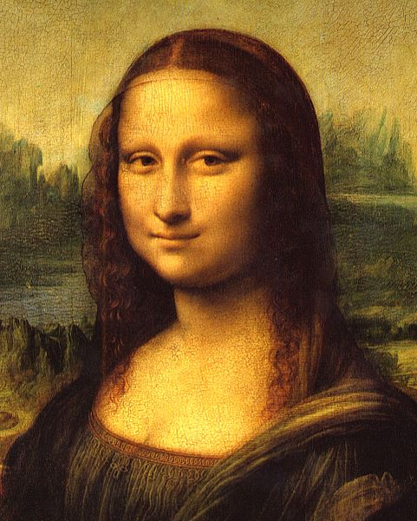
Page 1
Look at this picture. Write who is in this image. _____________
Go to the Wikipedia page of this image, in the 2nd picture from the top find the word that is used to make this “eeorhni” ( Anagram ) _________. Hint: Replace 2 consecutive letters in the word from the picture with the alphabet “P” to find the word. Ans: ____________ ( A1 ) .
3. Which countries / powers went to war in the year 1_ _ _ ( Fill it - E1 ) related to answer A1 ____________( A2 ) and_______________ (A3 )

Slide 5
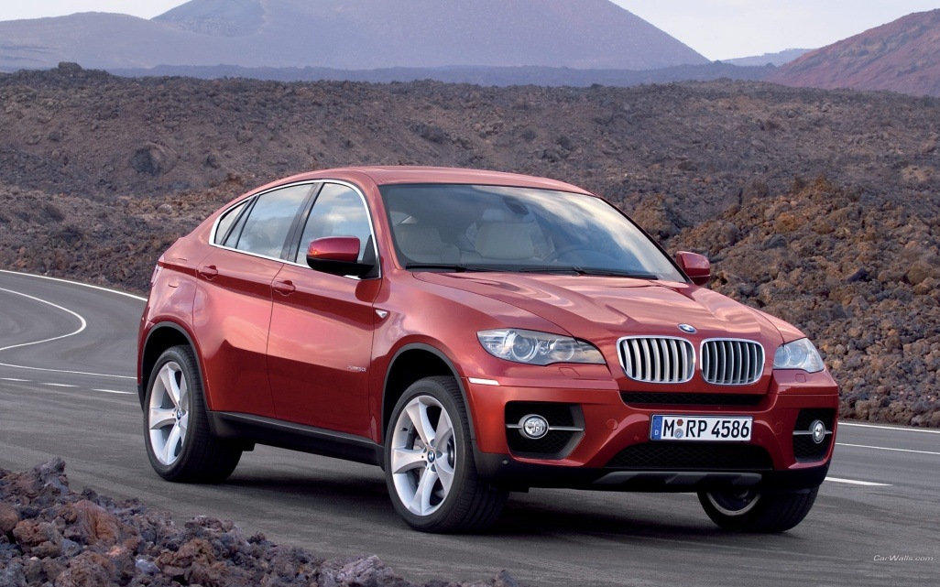
Page 2
4. Answer to “E1” is somewhere in this picture . It might be direct or jumbled. ______ ( E2 )
5. In the 1 _ 8 _ ( E3- last digit only ) picture of the _________ ( A2 ) , name any 2 animals that you see promptly. Fill in the blanks with 2nd and 4th numbers of E1. Animal names: ____________ ( A4 ) ______________ ( A5 ))
6. From the same picture what are the 3Fs written on top of the page.
____________ A6 ____________Y__ A7 ( Y ending letter )
____________N__ A8 ( N ending letter )
7. What tournament is played in India with the same word as ( A8) and it is related to which sport. _________ A9 ___________ ( sport ) A10

Slide 6
Page 3
8. According to the rule makers of this game ____ ( A10 ) which competitive sport is thought to be the earliest of this game. _______ A 11 .
9. In the Wikipedia page of this ancient game how many people are playing in the 2nd image from the top. ________ A12
10. Who is the director of the movie with the same number from answer A12 _______ ( A13) . Also which important day this movie highlights about __________ ( A14 )
11. Who is the famous tennis player who has the same last name as the answer A13 __________ ( A15 )
12. On the Wikipedia page of A14 what year you see on the 2nd image from the top __________ ( A16 ) Eg: 2002

Slide 7
Page 4
13. What colors you see in the picture for the number that is same as the last digit of A16. ______________________ A17 ( write colors separated by commas ) .
14. In this image which number comes one less than the occurrence of the last digit of A16. _____ ( A 18 ) Hint: Difference between A16 and A18 should not be more than 2 and A18 should be more than A16.
15. What is A16 divided by sum of 1st and last number of E1 _____ ( E4 ) , E3 divided by 2 ________ ( E5 ) . Hint: A16/E4,E5 or eg: 2012/45 _______ ( A19 )
16. On one of the image on this Wikipedia page of this US highway ( A19 ) whose famous name is written on a board. _________________ ( A20 )
17. How many children for this famous person ______ A21
18. Who is the famous actor whose 1st name is the same as the 1st name of A20 _________ ( A22 ) He is born in the year 19_ ( last digit of A16 ) _ ( A21) ( E6 )

Slide 8
Page 5
19. A21 cube + E6 = ? ____ ( A23 )
20. Search A23 in Google and visit the .gov site listed in the search top 10 results. Under the summary on this page what is the word in the last line that starts with P and ends with s _____ ( A 24 )
On the Wikipedia page of A24 what text points to the dark blue ball shaped item in the 4th image from the top. Write the exact text here ___________ ( A25 )
Google Search the word ending with “n” which is part of A25 but not same as A24. Who is the writer of the movie with same word _________ A26.
First name of the writer is the same as part of a domain that has the word “fun” in it’s homepage. Go to that website ______________ A27 ( write URL here )
In news published about this site which site or magazine or news site talks about “ top 10 ……..“ Answer is somewhere in A27. _____________ A 28
Search for A28 in Google and go to BBC’s section for this name. Click on the image link related to war. In the main image find the following. No of people in picture _____ A29 , Letter written on cone cap and the cap color ___________ A30 and ___________ A31 ( color ) , visible numbers __________ A32 ( write separated by commas ) .
Which variety of a sea creature has same color as A31 but is very rare? ( Estimated to be one in a million ) _________ A 33

Slide 9
Page 6
27. In the Wikipedia page of A33 what is next to A33 in a dinner plate ( 2nd image from top ) . ________ A34
28. Go to the Washington website of the 2nd part of A34. ___________ A35 ( website URL )
29. In the legacy video on A35, What is the number the narrator tells at 1.03 sec of the video __________ A36 . Hint video is somewhere on the site, take help from Google.com .
30. Divide A36 by 100 ________ E(10), Google this number , go to the 1st result of the Wikipedia page that talks about an isotope. In that page what is the number you see on the 1st image ____________ A37

Slide 10
Find this number series
Find this number series and solve the puzzle in the last page to find the treasure.
A12,last digit of E6-1,number of characters in 1st name of A12, multiple 1st 2 digits of E(10), A21x2,No of characters in A7-1,No of characters in A8,Total characters in A20 excluding spaces , sum of 1st 3 digits of A16+ 1, No of characters in A31 multiplied by A18 minus 20

Slide 11
Final Treasure puzzle – GOOD LUCK
18,8,4,6,8,27,22,12,12,24,12,21,30,18,6,4,28,22,26,18,27,18,6,27,8,20,24,12,27,8,22,9,4,27,16,18,27,8,30,12,4,21,30,4,18,8,21,30,4,n,d,4,12,4,27,6,9,12,22,30,4,30,30,12,8,6,18,21,9,8,27,8,21,6,8,30,4,3,18,8
Our Support team is happy to answer questions
Contact us : contemposeg@gmail.com

