Slide 1
Search Engine Optimization (SEO)
Notes:
Most techniques = common sense …
Search engine success = integration common sense
Surface - search engines and search engine optimization
Increase sales, traffic, and conversions

Slide 2
Agenda
What is a Search Engine?
Examples of popular Search Engines
Search Engines statistics
Why is Search Engine marketing important?
What is a SEO Algorithm?
Steps to developing a good SEO strategy
Ranking factors
Basic tips for optimization
Notes:
My agenda for today will encompass the following high level topics and I have allocated 4-8 minutes for Q&A session.
I will also email list of resources if you are interested in exploring SEO and other internet marketing techniques such as email marketing, PPC ads, in-line text, etc.

Slide 3
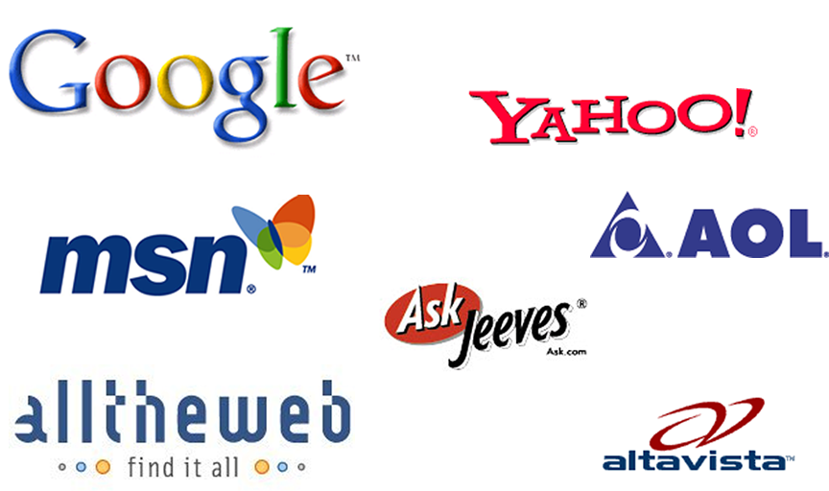
Examples popular Search Engines
Notes:
Today the undisputed leader in search engine usage is Google.
Yahoo Claims to have the largest index of all search engines ranking over 5 Billion pages.
MSN is the leading third, they have done a tremendous job at catching up to Google and yahoo but they still have a long time to catch up…. This a true example of the first mover advantage ☺
I don’t usually talk about Ask Jeeves but I have been seeing an increased level of traffic from Ask.com and according to recent statistics, Ask is now representative of approximately 7-8% of all searches.
Every search engine has a different algorithm and ranking…. Our main focus today will be to look at the common and basic elements that every search engine company uses to rank and index pages.

Slide 4
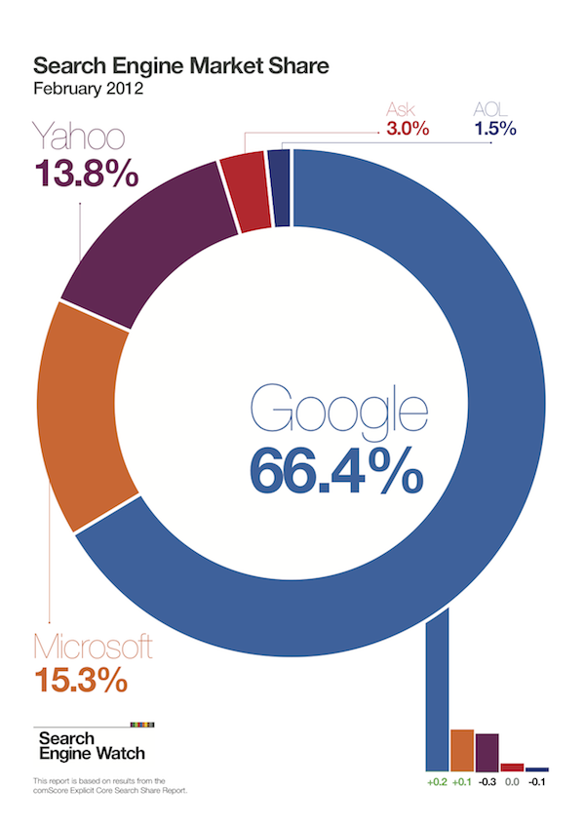
Notes:
Today the undisputed leader in search engine usage is Google.
Yahoo Claims to have the largest index of all search engines ranking over 5 Billion pages.
MSN is the leading third, they have done a tremendous job at catching up to Google and yahoo but they still have a long time to catch up…. This a true example of the first mover advantage ☺
I don’t usually talk about Ask Jeeves but I have been seeing an increased level of traffic from Ask.com and according to recent statistics, Ask is now representative of approximately 7-8% of all searches.
Every search engine has a different algorithm and ranking…. Our main focus today will be to look at the common and basic elements that every search engine company uses to rank and index pages.

Slide 5
How Do Search Engines Work?
Spider “crawls” the web to find new documents (web pages, other documents) typically by following hyperlinks from websites already in their database
Search engines indexes the content (text, code) in these documents by adding it to their databases and then periodically updates this content
Search engines search their own databases when a user enters in a search to find related documents (not searching web pages in real-time)
Search engines rank the resulting documents using an algorithm (mathematical formula) by assigning various weights and ranking factors
Notes:
If you were not take anything away from this session today… and only understand how Spider or crawlers work you would have understood 40% of Search engines.

Slide 6
How Do Search Engines Work?
Spider “crawls” the web to find new documents (web pages, other documents) typically by following hyperlinks from websites already in their database
Search engines indexes the content (text, code) in these documents by adding it to their databases and then periodically updates this content
Search engines search their own databases when a user enters in a search to find related documents (not searching web pages in real-time)
Search engines rank the resulting documents using an algorithm (mathematical formula) by assigning various weights and ranking factors
Notes:
If you were not take anything away from this session today… and only understand how Spider or crawlers work you would have understood 40% of Search engines.

Slide 7
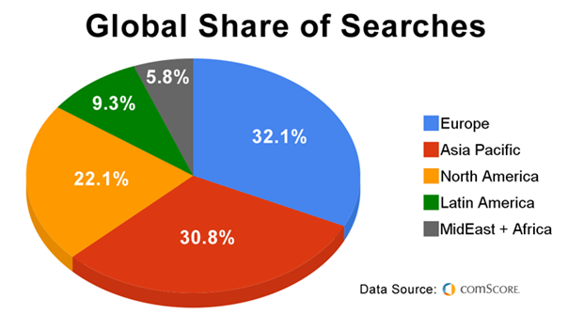
100+ Billion Searches / Month
Notes:
According to Nielsen/Net rating

Slide 8
Important?
80% of consumers find your website by first writing a query into a box on a search engine (Google, Yahoo, Bing)
90% choose a site listed on the first page
85% of all traffic on the internet is referred to by search engines
The top three organic positions receive 59% percent of user clicks.
Cost-effective advertising
Clear and measurable ROI
Operates under this assumption:
  More (relevant) traffic + Good Conversions Rate = More Sales/Leads

Slide 9
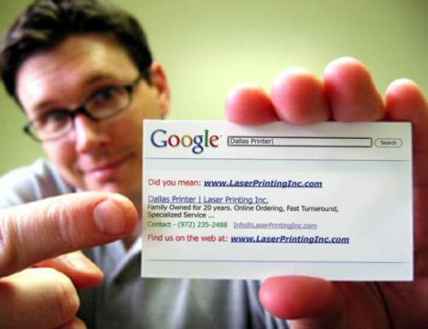
Business Card

Slide 10
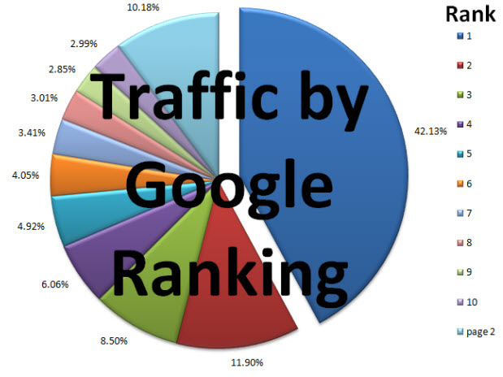
SEO Effectiveness
Notes:
Directory are listing of static information that are usually inputted manually and not CRAWLED.
Some of the common characteristics of today’s search engines are as follows:
* A search engine component usually contain the following components… I would like you to take a mental note of the Spider … since this will be a important topic we will discuss later on today.
In early day’s for you who remember this WebCrawler was one of the many crawler based directory search engines …. another common one that still exists today is AltaVista search engine.

Slide 11
What is SEO?
SEO = Search Engine Optimization
  Refers to the process of “optimizing” both the on-page and off-page ranking factors in order to achieve high search engine rankings for targeted search terms.
  Refers to the “industry” that has been created regarding using keyword searching a a means of increasing relevant traffic to a website

Slide 12
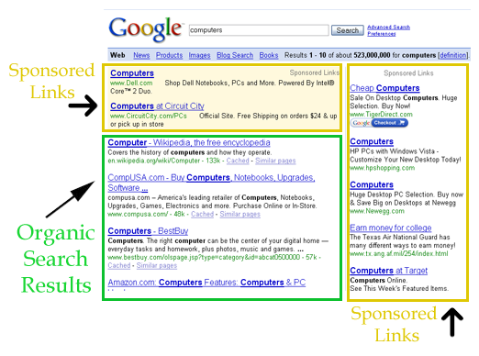

Slide 13
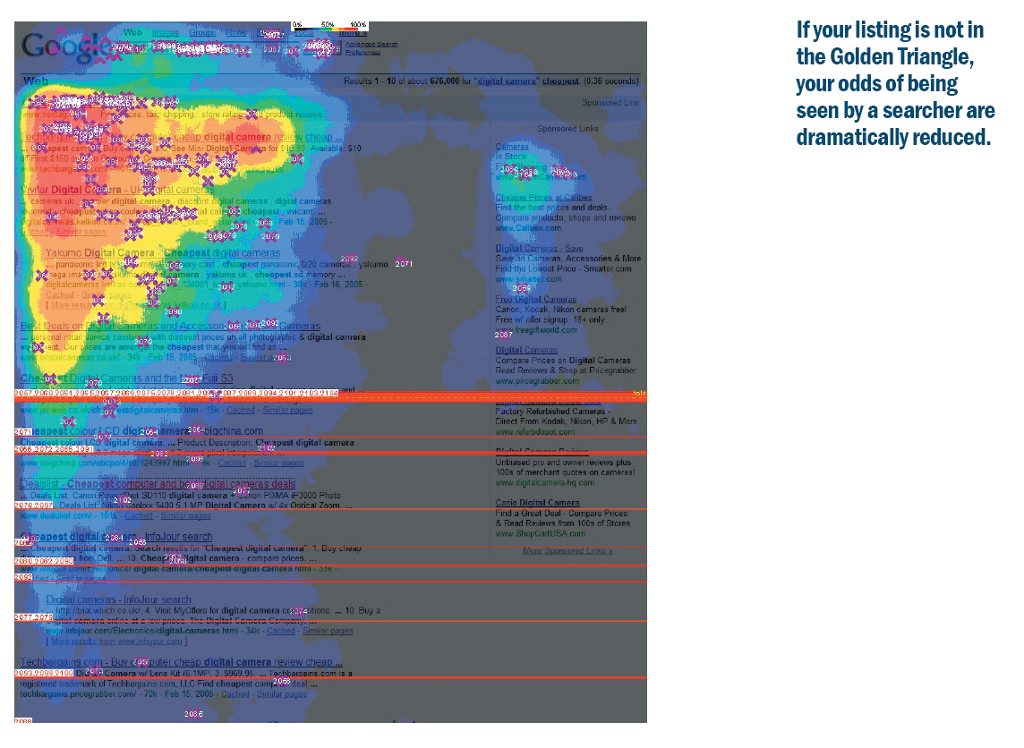

Slide 14
What is a SEO Algorithm?
Top Secret! Only select employees of a search engines company know for certain
Reverse engineering, research and experiments gives SEOs (search engine optimization professionals) a “pretty good” idea of the major factors and approximate weight assignments
The SEO algorithm is constantly changed, tweaked & updated
Websites and documents being searched are also constantly changing
Varies by Search Engine – some give more weight to on-page factors, some to link popularity

Slide 15
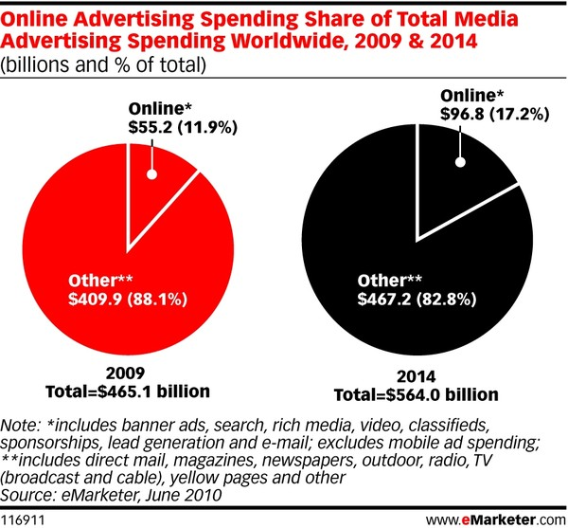
Online Spending Growth

Slide 16
A good SEO strategy:
Research desirable keywords and search phrases
(WordTracker, Overture, Google AdWords)
Identify search phrases to target (should be relevant to business/market, obtainable and profitable)
“Clean” and optimize a website’s HTML code for appropriate keyword density, title tag optimization, internal linking structure, headings and subheadings, etc.
Help in writing copy to appeal to both search engines and actual website visitors
Study competitors (competing websites) and search engines
Implement a quality link building campaign
Add Quality content
Constant monitoring of rankings for targeted search terms

Slide 17
Ranking factors
On-Page Factors (Code & Content)
    #3 - Title tags <title>
    #5 - Header tags <h1>
    #4 - ALT image tags
    #1 - Content, Content, Content (Body text) <body>
    #6 - Hyperlink text
    #2 - Keyword frequency & density
Off-Page Factors
    #1 Anchor text
    #2 - Link Popularity (“votes” for your site) – adds credibility
Notes:
Anchor text is the visible hyperlinked text on the page.
anchor text is usually used to indicate the subject matter of the page that it links to. For example, the text “7th world congress ebusiness" indicates to visitors that they can expect to see content about conference pertaining to ebusiness if they visit the link.
This pattern of usage has been applied in search engine algorithms to enhance the relevance of the "target" or the "landing page" URL for the keywords appearing within the anchor text.

Slide 18
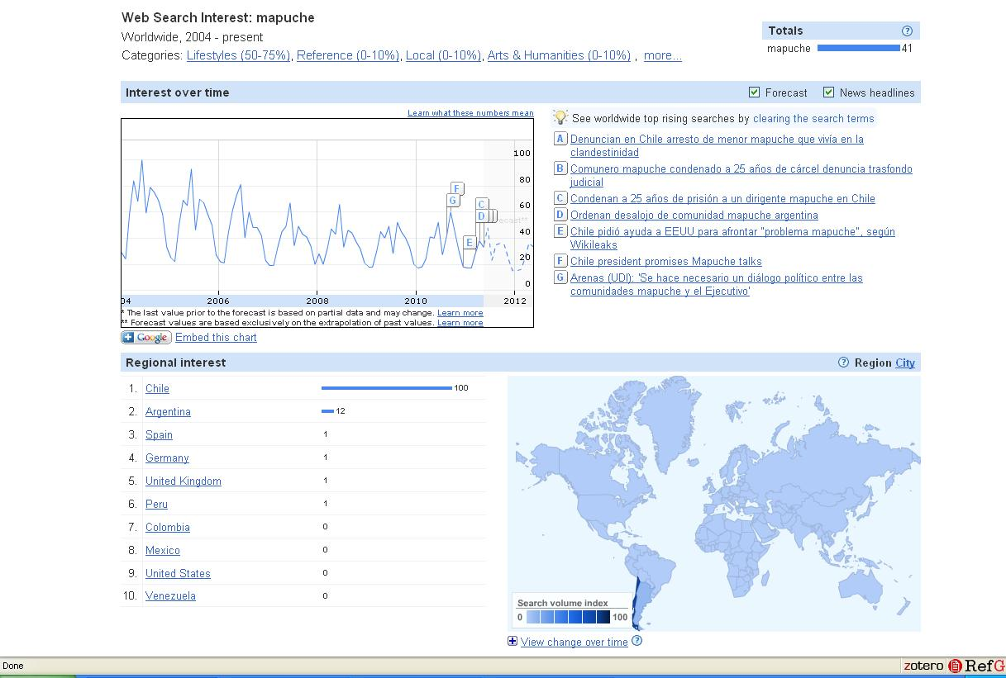
Google Insights for Search

Slide 19
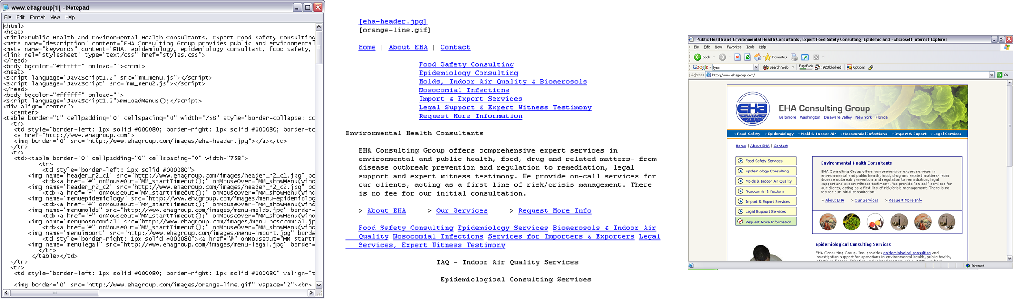
What a Search Engine Sees
View > Source (HTML code)

Slide 20

Pay Per Click
PPC ads appear as “sponsored listings”
Companies bid on price they are willing to pay “per click”
Typically have very good tracking tools and statistics
Ability to control ad text
Can set budgets and spending limits
Google AdWords and Overture are the two leaders

Slide 21
PPC vs. “Organic” SEO
Pay-Per-Click | “Organic” SEO
results in 1-2 days easier for a novice or one little knowledge of SEO ability to turn on and off at any moment generally more costly per visitor and per conversion fewer impressions and exposure easier to compete in highly competitive market space (but it will cost you) Ability to generate exposure on related sites (AdSense) ability to target “local” markets better for short-term and high-margin campaigns | results take 2 weeks to 4 months requires ongoing learning and experience to achieve results very difficult to control flow of traffic generally more cost-effective, does not penalize for more traffic SERPs are more popular than sponsored ads very difficult to compete in highly competitive market space ability to generate exposure on related websites and directories more difficult to target local markets better for long-term and lower margin campaigns

Slide 22
Tips & Optimization Techniques
Research keywords related to your business
Identify competitors, utilize benchmarking techniques and identify level of competition
Utilize descriptive title tags for each page
Ensure that your text is HTML-text and not image text
Use text links when ever possible
Use appropriate keywords in your content and internal hyperlinks (don’t overdo!)
Obtain inbound links from related websites
Monitor your search engine rankings and more importantly your website traffic statistics and sales/leads produced
Educate yourself about search engine marketing

Slide 23
Thank You

